Slide 1
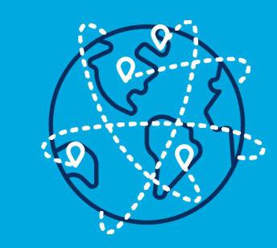
#Beinternational quiz
International
Education Week 2019-20
18-22 November #BeInternational

Slide 2

How many languages are there in the world?
Between 2000
and 2500 (b –
around 2,200)
About 100
Between 2000 and 2500
More than 400

Slide 3

1) what is the most spoken language in the world (as a National Language) ?
a)Chinese
b) Spanish
c) Elish
d) Arabic
e) Hindi
中文啊！
Chinese! (a)

Slide 4
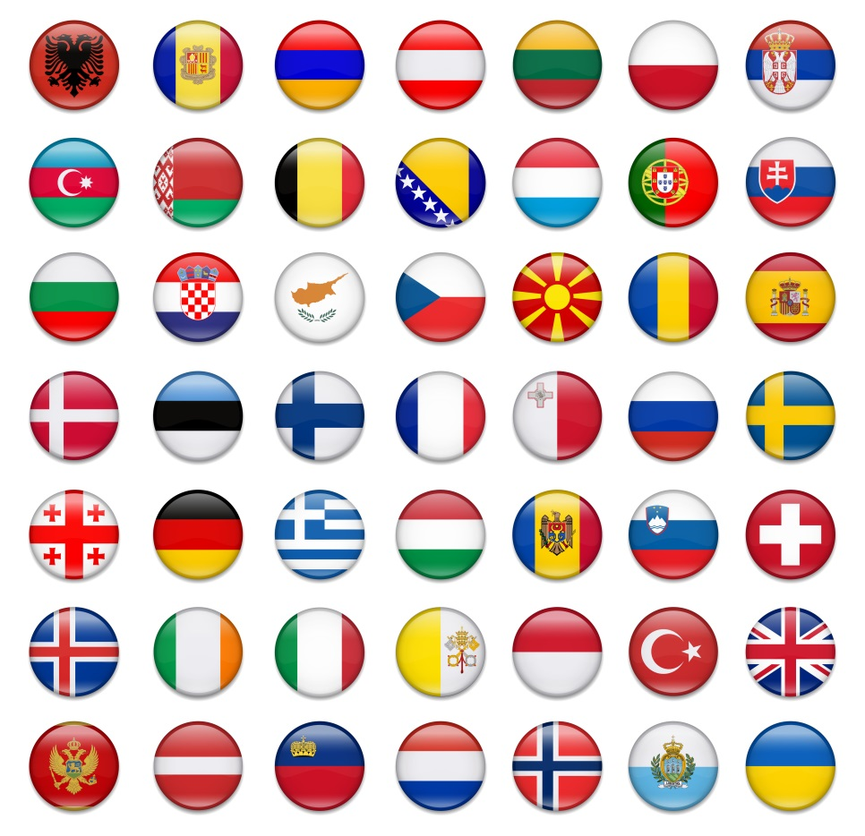
2) How many European languages are there?
Less than 100
100-200
200-300
300-400
200-300
(c)

Slide 5
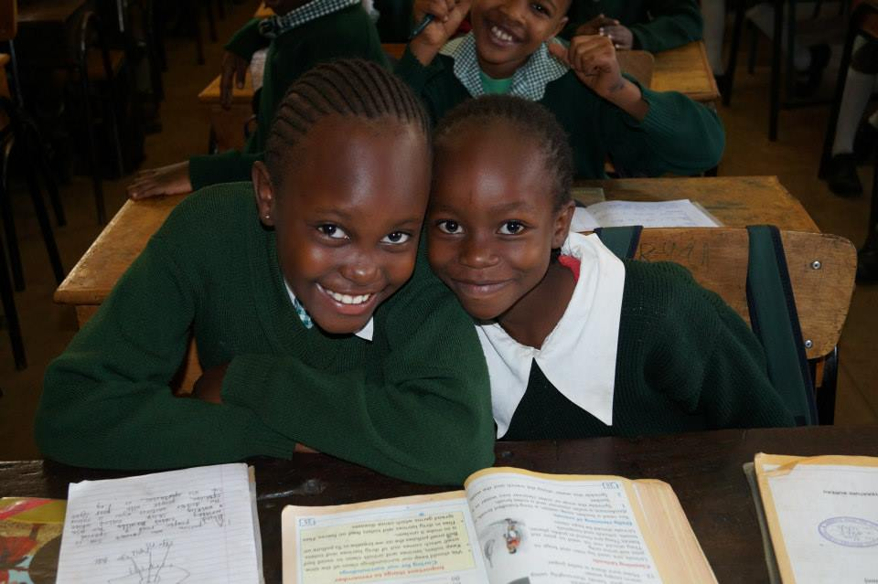
3) What proportion of all the languages in the world are African languages?
1 in 2
1 in 3
1 in 5
1 in 10
1 in 3 (b)

Slide 6

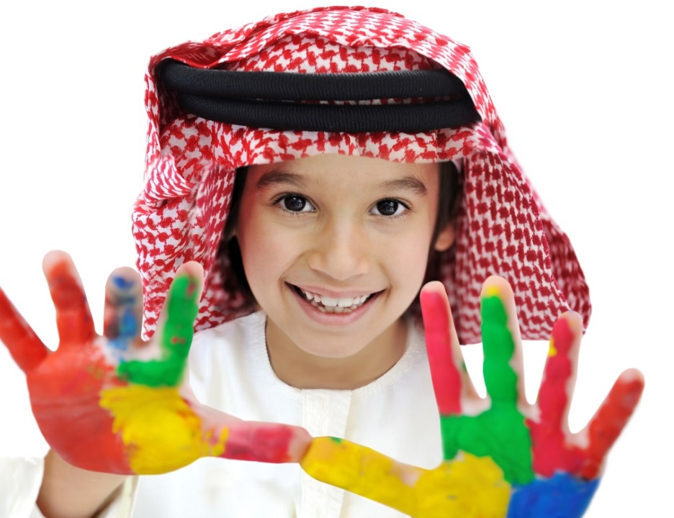

4) Which of the following is written from right to left?
Arabic
Japanese
Albanian
Hindi
Arabic
(a)

Slide 7
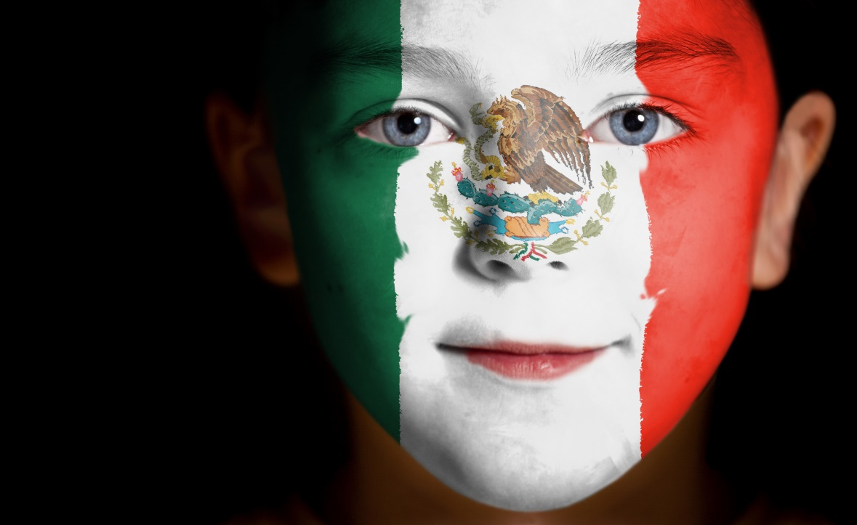
5) Which country has the largest number of Spanish native speakers?
Spain
Colombia
Mexico
USA
Méjico
Mexico
(c)

Slide 8


6) How many people in the world speak English?
Almost everyone
About 480 million
About 100 million
About 480
million (c)

Slide 9
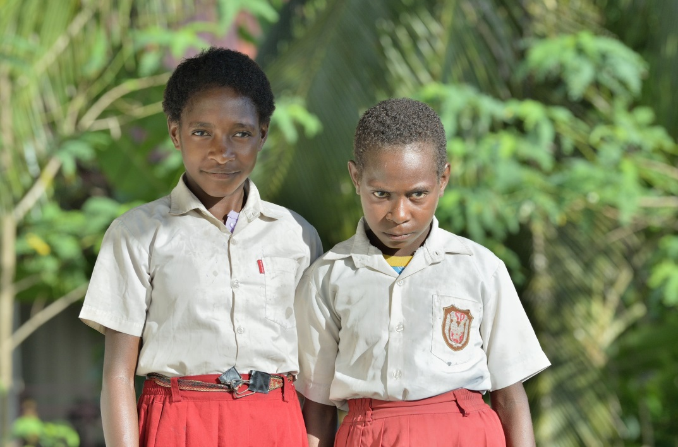
7) What’s the largest number of languages spoken in any one country?
About 800
Between 400 and 600
About 200
836 in Papua
New Guinea
(a)

Slide 10

8) How many words do you think you could speak when you were 18 months old?
Between 30
and 70
(b - actually around 50)
About 20
Between 30 and 70
More than 100

Slide 11

By the time you were five years old, how many words could you speak?
About 1000
Between 2000
and 2500
More than 4000
Between 2000
and 2500 (b)

