Slide 1
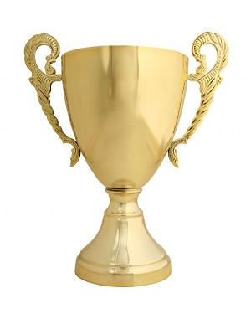
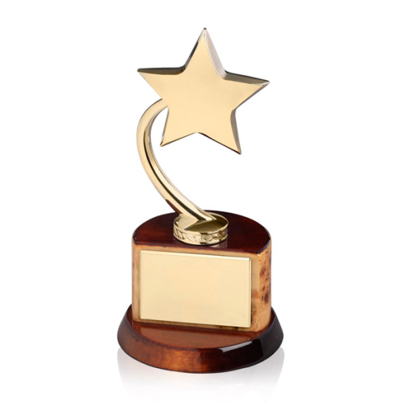
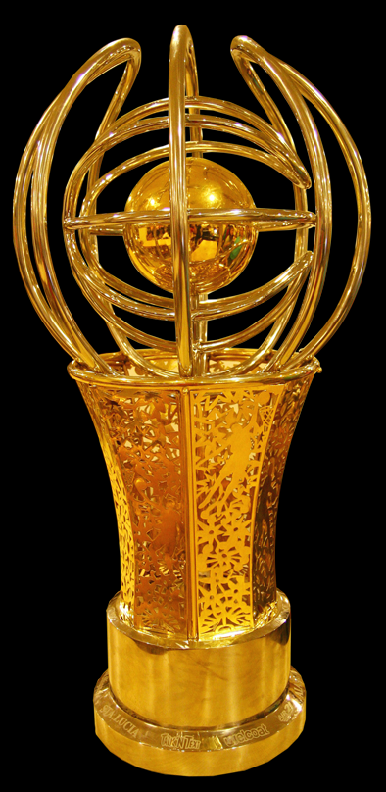

El gran concurso de fin de año

Slide 2
1. Which is the largest town in the world?
Tokio
Nueva York
Mexico

Slide 3
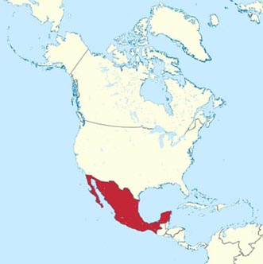
2.Where is Mexico placed in the map ?
North America
Central America
South America

Slide 4
2.Where is Mexico placed in the map ?
North America
Central America
South America

Slide 5
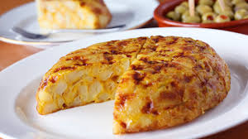
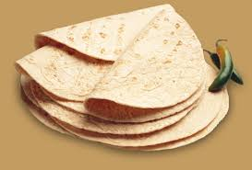
3. What’s the difference between a Spanish tortilla and a Mexican tortilla?
Both are made of fried potatoes.
One has potatoes and the other is a kind of pancake made of lemon.
One is made of potatoes and eggs and the other is made of corn.

Slide 6
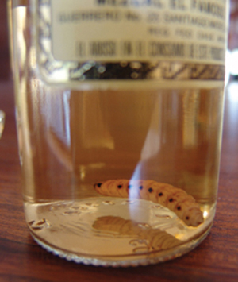
4. What is unusual about the Mexican drink Mezcal?
It tastes like a ray!
It contains a worm.
It contains a butterfly.

Slide 7
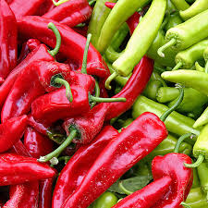
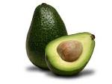
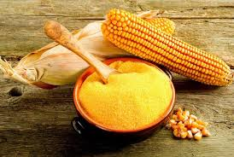
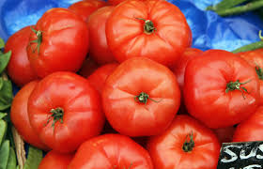
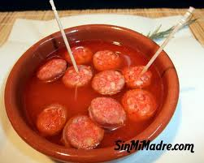
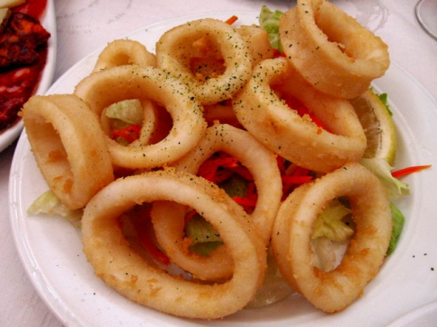
5. What are the key ingredients in Mexican cooking?
b
c
d
a
e
f

Slide 8
6.
¿Cómo se dice…..?
How are you doing?
a. ¿Qué tal?
b. ¿Dónde estás?
c. ¿Qué quieres para comer?

Slide 9

7
¿Cómo se dice…..?
Awesome!
a. Fatal
b. Fenomenal or Estupendo
c. No me gusta nada

Slide 10
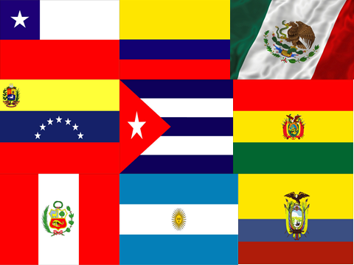
8. Which is the flag of Mexico?
a
b
c
d
g
f
h
i
j
Notes:
Chile-Santiago, Colombia-bogotá, Mexico- ciudad de Mexico, Venezuela-Caracas, Cuba-La havana, Bolivia-La paz, Peru-Lima, Argentina-Buenos Aires, Ecuador-Quito

Slide 11
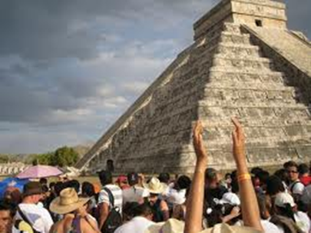
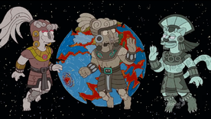
9. Which is the flag of Mexico?
Chichen Itza in the Yucatan peninsular of Mexico is home to some of the most spectacular examples of the temples of which civilization?
Los espaňoles.
Los mexicanos.
Los mayas .

Slide 12

Gracias.
Adiós amigos.

