Slide 1
Gap Tasks (GT)
Can you complete any gap task in your exercise book?
( 3mins)

Slide 2
Starter
What is the weather like today? Talk pair in pairs. What do you remember?
Can you use the weather chart today?

Slide 3
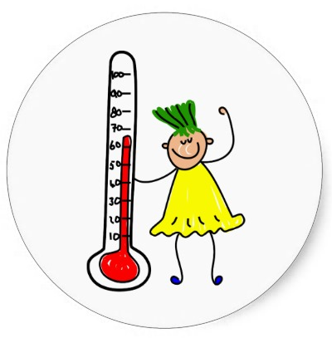
Jueves veinticuatro de noviembre de 2016
Can talk about Spanish cultures and traditions?
Context: Spanish Traditions.
_________________________
0 10
Success criteria:
*I can talk about Spanish culture and traditions.
*I can compare to English and Indian culture.
*I can recognise the written word.
*I can use correct pronunciation

Slide 4
How confident do you feel? Use your learning line.

Slide 5
What is a tradition? Reflect in pairs.

Slide 6
Looking at different traditions in Spain - bbc
http://www.bbc.co.uk/schools/primarylanguages/spanish/my_calendar/videos/
Repite conmigo
http://www.bbc.co.uk/schools/primarylanguages/spanish/my_calendar/celebrations/http://www.bbc.co.uk/schools/primarylanguages/spanish/my_calendar/celebrations/

Slide 7
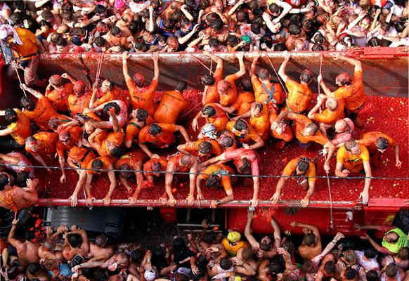
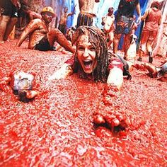
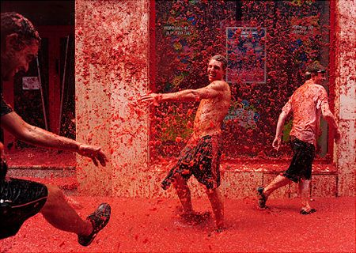
La tomatina
https://www.youtube.com/watch?v=FEJ0JTUQkQI
In Buñol, Valencia.
In Agosto.
It is called tomato fight.
At 10 and 11 am. Big lorries carry tomatoes.
Firemen clean up streets with water.

Slide 8
Video tomatina in English
https://www.pinterest.com/pin/145944844146401678/

Slide 9
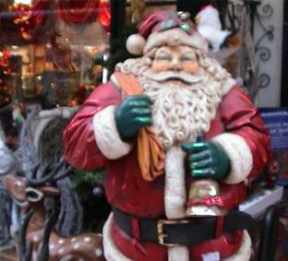
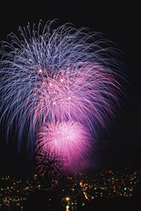

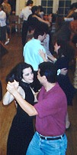
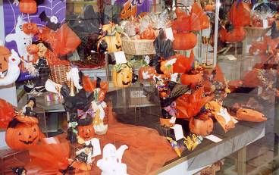
What traditions have you got in your country?
Describe what do you do in England to celebrate these festivites.
Can you compare your traditions with the Spanish and Indian ?
What is similar or different?
Notes:
Pupils use the information on the previous slides to compare a traditional celebration in their own country with one that takes place in Spain or Latin America.

Slide 10
How much confident do you feel? Use your learning line.

