Slide 1
Gap Tasks (GT)
Can you complete any gap task in your exercise book?
( 3mins)

Slide 2
Starter
Which is the sentence?

Slide 3


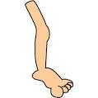
Mi extraterrestre tiene....
1
2
3
un ojo
dos manos
tres piernas

Slide 4
Mi monstruo tiene....
1
2
3
el ojo
la mano
la pierna

Slide 5
Martes ocho de noviembre de 2016.
Can describe my monster by using colours and numbers ?
Context: Description of a monster.
______________________________
0 10
Success criteria:
*I can name some colours in Spanish.
*I can use colours to describe body parts.
*I can recognise the written word.
*I can use correct pronunciation

Slide 6
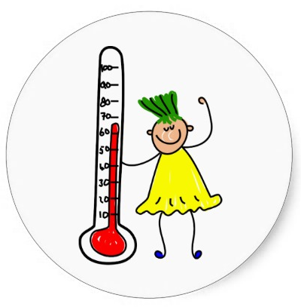
How confident do you feel?
Use your learning line.

Slide 7
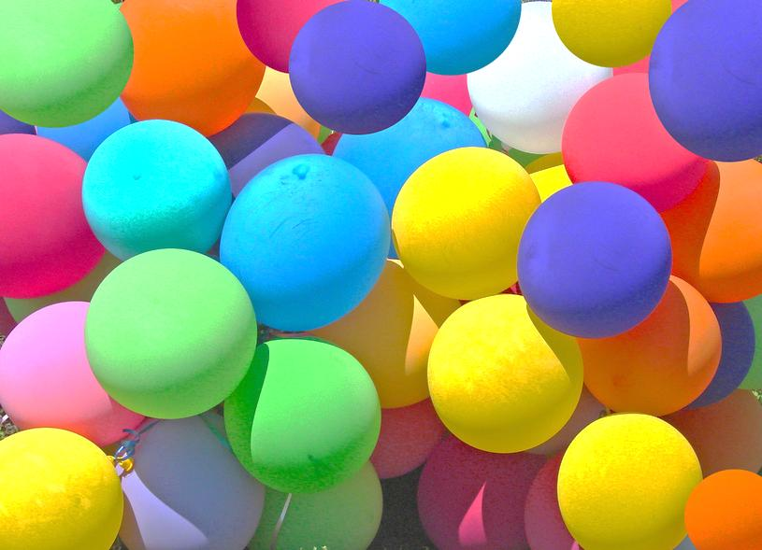
Los Colores

Slide 8
Cancion los colores
https://www.youtube.com/watch?v=c6BVOQfgMP8

Slide 9
What is your favourite colour?-
Mi color preferido es el violeta.
How many colours do you remember in Spanish?
Can you match the Spanish and the English words? Use colours
1. azul
2. rojo
3. amarillo
4. marrón
5. naranja
6. violeta
7. verde
8. rosa
a. red
b. yellow
c. blue
d. orange
e. pink
f. green
g. violet
h. brown

Slide 10


Mi color favorito es el rosa-
My favourite colour is pink
¿Cuál es tu color favorito, Peggy ?-What is your favourite colour, Peggy?

Slide 11
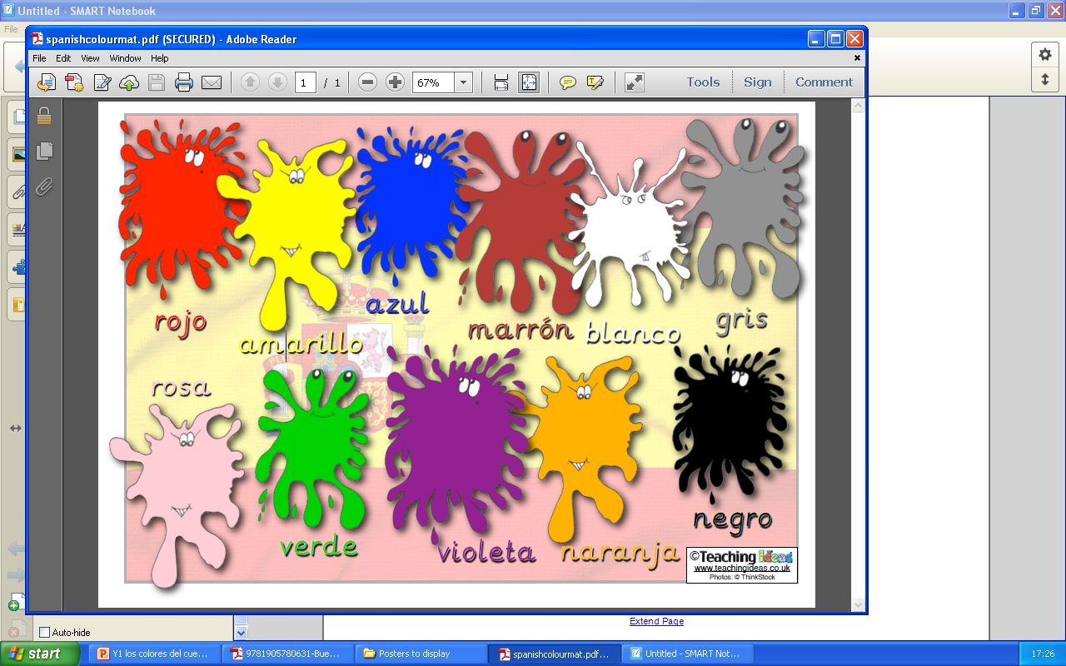

Slide 12
La canción de los colores
https://www.youtube.com/watch?v=DsRKoZGaoEMhttps://www.youtube.com/watch?v=DsRKoZGaoEM

Slide 13
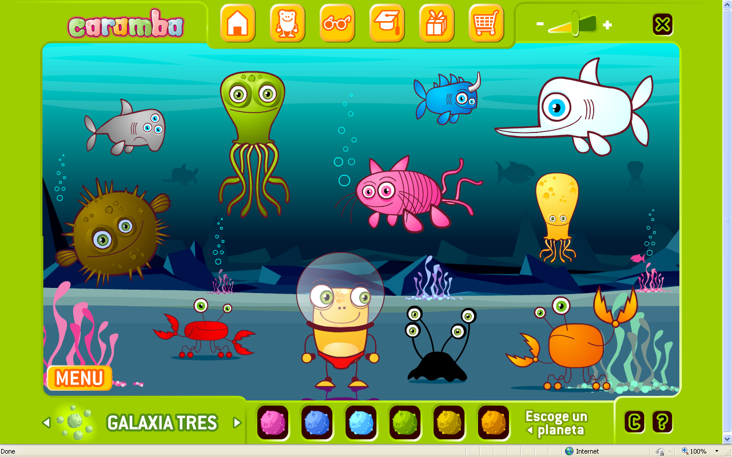

Slide 14
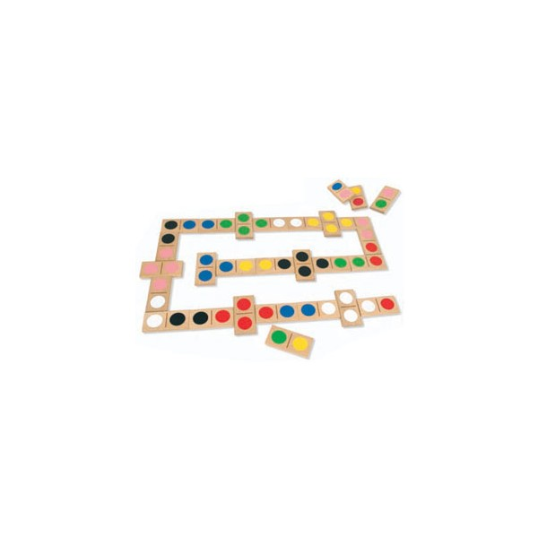
El dominó de los colores
Play with your group to the domino of the colours.
Match the cards (Spanish with the English word)
If you finish colour the grids.

Slide 15

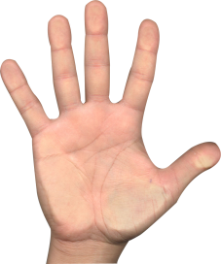
Can you describe this monster by using colours?
Mi monstruo es verde
tres ojos es azules
La pierna gris
dos manos rojas.

Slide 16
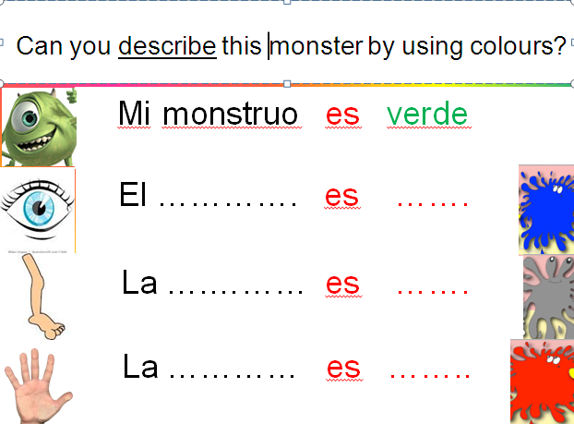

Slide 17
Can you describe an alien using numbers and colours?
Mi monstruo tiene un ojo azul y dos manos verdes.
My monster has one blue eye and two green hands .

Slide 18
How much confident do you feel?
Use your learning line.

