Slide 1
Zones of Regulation!!!
Parent workshop

Slide 2
Zones of regulation help…
1. Help children gain skills in labelling their feelings, a lot of the time parents/ teachers do this for them.
Develops independence and leads to more control and the ability to problem-solve.
Gives the children a toolbox and methods to deal with this especially as mental health needs are increasing.

Slide 3
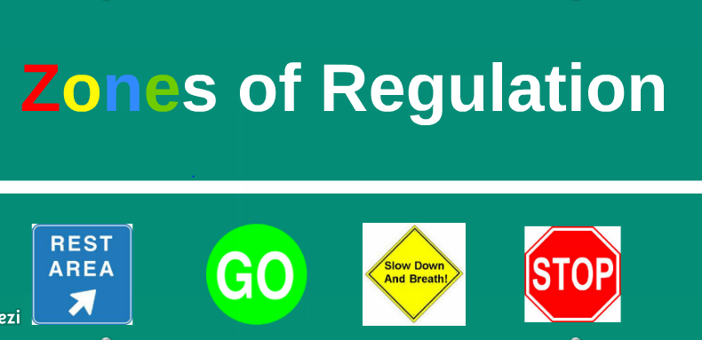

Slide 4
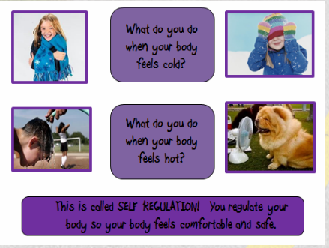
What is self regulation?
The ability to focus your attention, control your emotions and manage your thinking, behaviour and feelings.
Notes:
How do we regulate ourselves? Talk about things you might do to help regulate your own emotions.

Slide 5
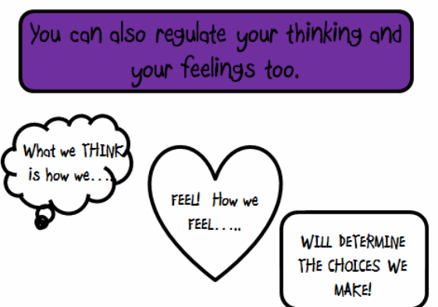
Notes:
If we can recognise how we think and feel we can see how it impacts on the choices we make- give some examples of how your feelings and emotions can impact on the choices you make.

Slide 6
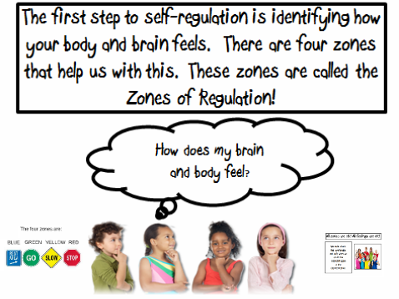
Notes:
Identifying what mood we are in is difficult- use colours for identification. Children need to know how their zones feel for them- personalise-

Slide 7
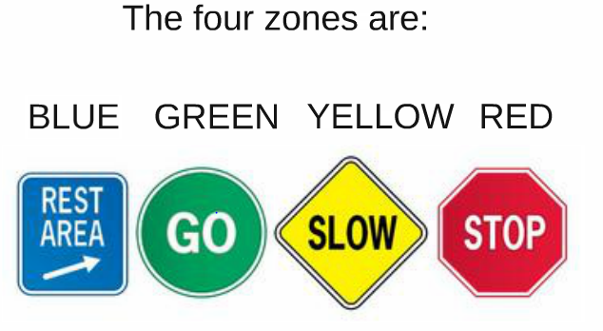
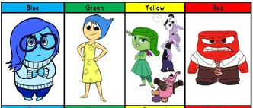

Slide 8
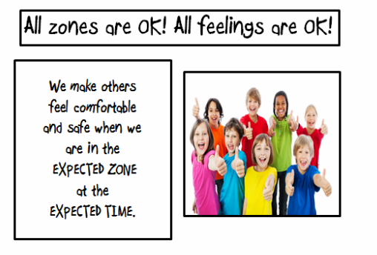

Slide 9
The Blue Zone

Slide 10
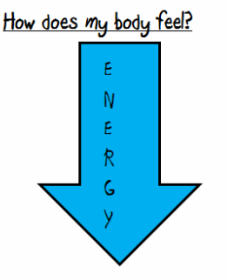
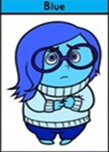

The Blue Zone
We are expected to be in the Blue Zone just before bed time or when we are watching the TV. We are running slow! We might be tired or sad. This is not an expected zone to be in for learning.

Slide 11
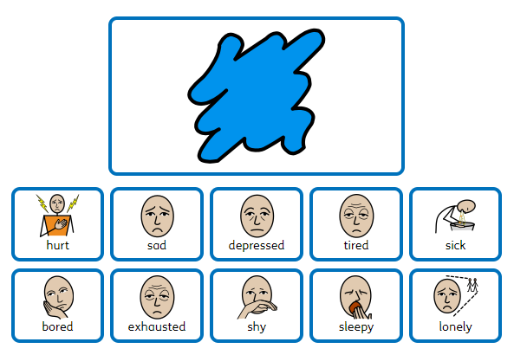

Slide 12

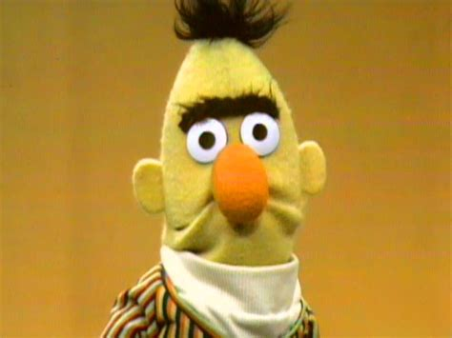
Bert feels sad
https://www.youtube.com/watch?v=ZgRN-AytScE

Slide 13
The Yellow Zone

Slide 14
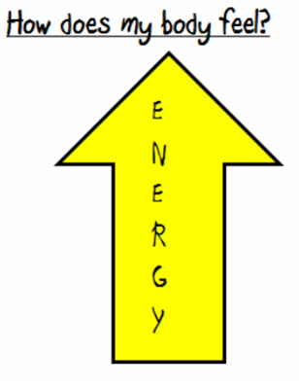
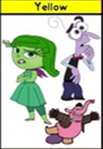
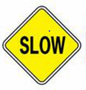
The Yellow Zone……during play time, lunch time and even at the end of the day, it’s expected for us to be in the YELLOW ZONE!!

Slide 15
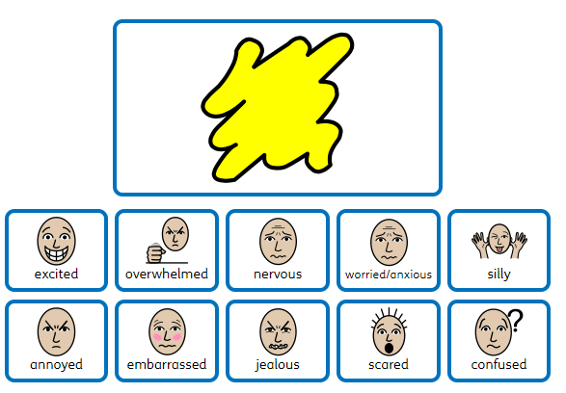

Slide 16
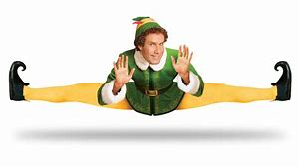
Elf in the yellow zone
https://www.youtube.com/watch?v=b6yYd6Pq7Ic&list=PLNtcYq0vdW0bE_Qc2fr-9zbngdax8rd7m

Slide 17
The Green Zone

Slide 18
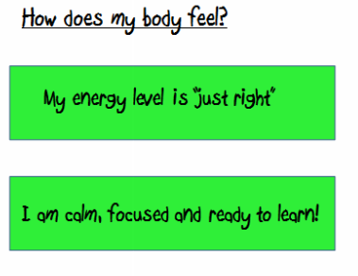
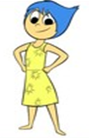

The green zone…..the learning zone!!
We are expected to be in the Green Zone while we are learning. It is when our brains and bodies are relaxed and focused!

Slide 19
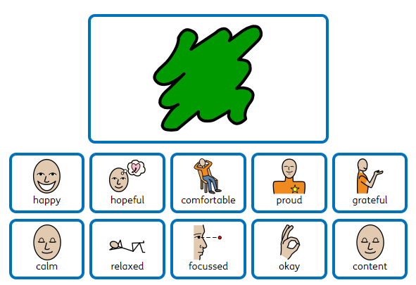

Slide 20
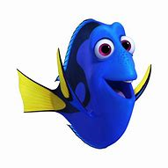
Dory in the green zone.
https://www.youtube.com/watch?v=sB6W2VAx2J8

Slide 21
The Red Zone

Slide 22
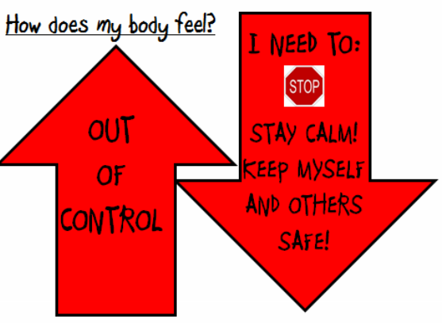
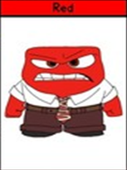

The Red Zone….when we are at school, is never expected, if it happens we need to deal with this straight away! We must keep ourselves and others safe!

Slide 23
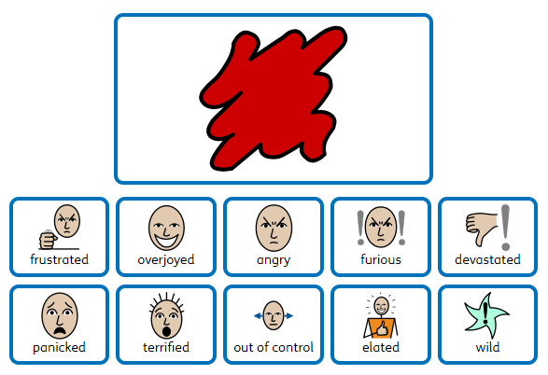

Slide 24
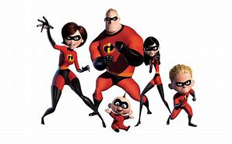
The Incredibles in the red zone!
https://www.youtube.com/watch?v=3v196bt5kTU&list=PLex1ABIduQCnlXSJgLC4u0fLFVbJIleWm

Slide 25
How we introduced this in school
We went through one zone per week to get them familiar with these before moving on.
A “Zones of regulation” board is set up in each class – Here children identify their zones when they enter the class.
If yellow and blue children are not coping in class, they could be grouped together Blue + Yellow = Green.
Any red children will need to be worked with, to calm them down. (We would do this anyway with emotion coaching)
These zones do not link to the behaviour of traffic lights as all emotions are valid.

Slide 26
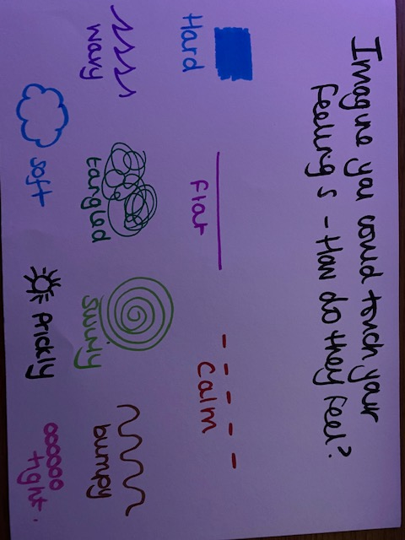
For younger children

Slide 27
My Toolbox

Slide 28
My Toolbox
Younger children – have a class toolbox
Older children – Children have a toolbox in their tray that they can use when needed.

Slide 29
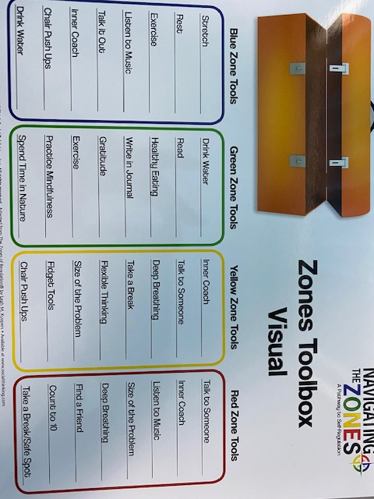
My Toolbox

Slide 30
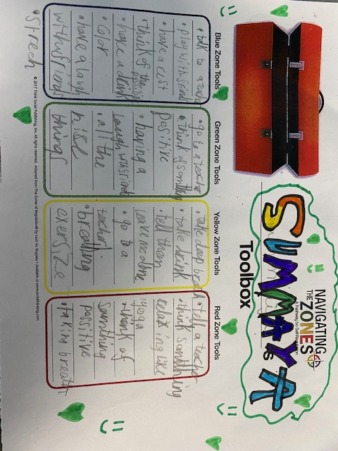
Year 5

Slide 31
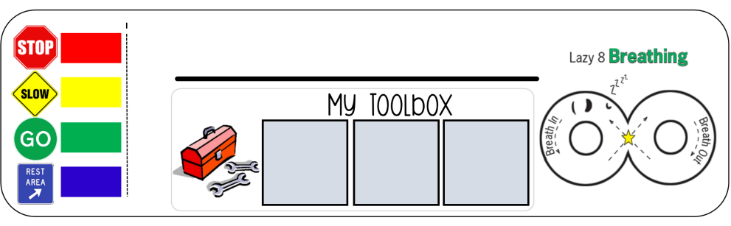

My Toolbox

Slide 32
Calming strategies

Slide 33
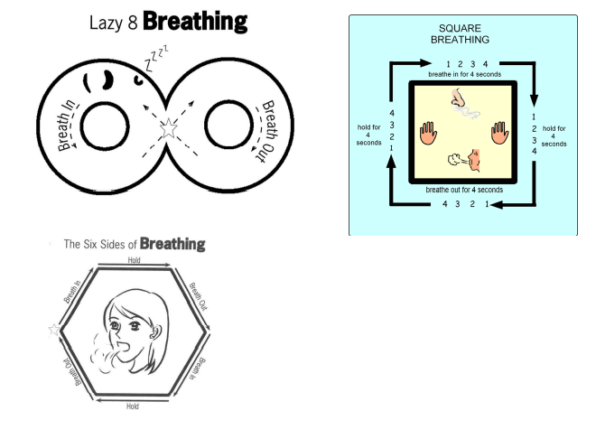
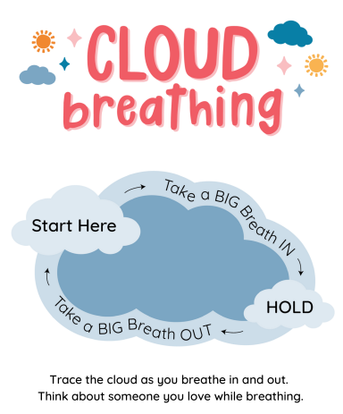
Breathing exercises

Slide 34
Feedback from the children
The children could name the zones of regulation and their emotional vocabulary has increased.
They identified how they struggle to remain in the green zone in the morning as there are too many tasks to do and asked for a calmer activity to be completed first thing.
Each child agreed that the toolbox of strategies helped them deal with challenges throughout the day.
Children identified that they would like this displayed more within the school, so they are now all around the school so it can be referred to.
Mostly, they mentioned how they would like to use the same language at home.

Slide 35
How to help with the zones at home?
Identify your own feelings using Zones language in front of your child (e.g.: I’m frustrated. I think I am in the Yellow Zone.”)
Talk about what tool you will use to be in the appropriate Zone (e.g.: “I need to take four deep breaths to help get me back to the Green Zone.”)
At times, wonder which Zone your child is in. Or, discuss which Zone a character in a film/book might be in. (e.g.: “You look sleepy. Are you in the Blue Zone?”)
Engage your child in discussion around Zones when they are in the Red Zone is unlikely to be effective. You need to be discussing the different Zones and tools they can use when they are more regulated/calm.
Teach your child which tools they can use. (eg: “It’s time for bed. Let’s read a book together in the comfy chair to get you in the Blue Zone.”)
Regular Check-ins. “How are you feeling now?” and “How can you get back to Green?”
Modelling It is important to remember to show the children how you use tools to get back to the green zones. You might say “I am going to make myself a cup of tea and do some breathing exercises because I am in the blue zone” and afterwards tell your child how using those tools helped you get back to the green zone.
Share how their behaviour is affecting your Zone. For example, if they are in the Green Zone, you could comment that their behaviour is also helping you feel happy / go into the Green Zone. • Put up and reference the Zones visuals and tools in your home.
Praise and encourage your child when they share which Zone they are in.

Slide 36
Any questions?

Slide 37
Thank you!

