Slide 1
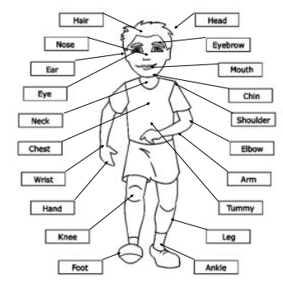
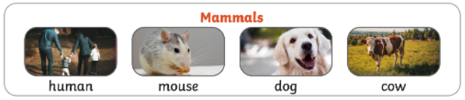
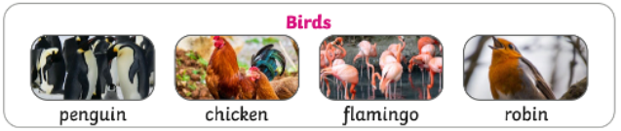
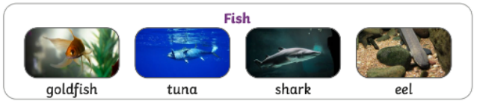
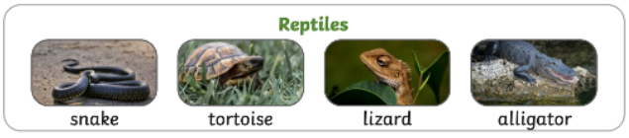
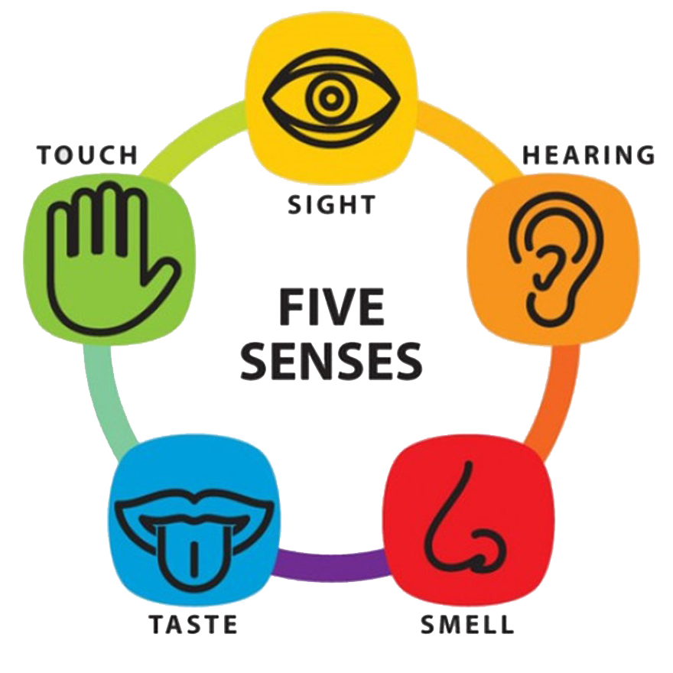
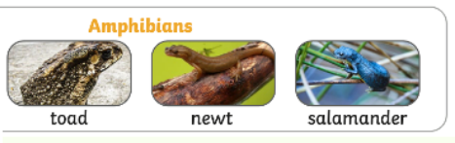
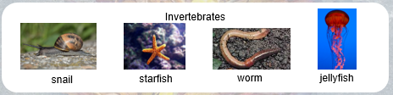
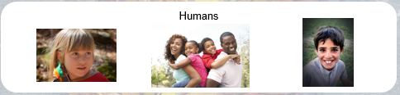

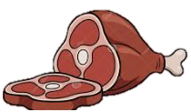












Animals, Including Humans – Year 1 – Autumn Term
Key Knowledge
 | Animals that feeds its young with milk from the mother and has skin usually more or less covered with hair.
 | Animals with feathers, wings and a beak which can usually fly.
 | Animals with gills and fins that live in water.
 | Animals which has dry, scaly skin and lays eggs on land.
 | Animals which can live on land or in water
 | Animals with no backbone.
 | We are called humans We are from the family of animals called mammals.
Useful websites
https://www.bbc.co.uk/bitesize/topics/z6882hv/articles/zp92xnb https://www.bbc.co.uk/bitesize/topics/z6882hv/articles/zc6br82 https://www.bbc.co.uk/bitesize/topics/z6882hv/articles/zyd6hyc https://www.bbc.co.uk/bitesize/topics/z6882hv/articles/zxgq2hv https://www.bbc.co.uk/bitesize/topics/z6882hv/articles/zp9pfg8
Herbivore (eats plants) | Omnivore (eats met and plants) | Carnivore (eats meat)

