Slide 1
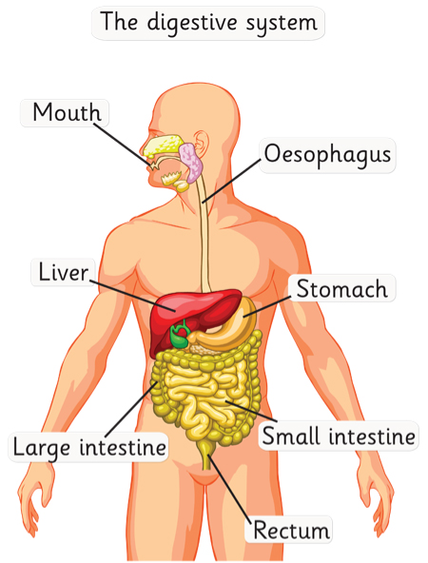

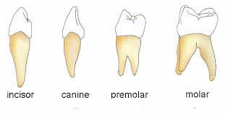
Animals, including Humans – Year 4 -Autumn Term
Key Knowledge
The Digestive System
What is digestion? | Digestion is the way the body breaks down the food we eat into smaller parts that can be used to give the body energy.
The Main Parts of the digestive system | Mouth, tongue, teeth, oesophagus, stomach and large and small intestine.
The digestive journey of food. | Humans put food into their mouth Food is chewed by teeth Food is swallowed and passed through the oesophagus to the stomach In the stomach, it is mashed into a mixture like soup and mixed with acid. The mixture passes into the small intestine, where tiny bits o of food pass into the bloodstream The food that is still left goes into the large intestine Finally, waste products leave the body.
Key Vocabulary
Definition
Energy | THe property that gives humans strength
Waste | A tough material that can be shaped Unwanted substance in the body
Useful websites
https://www.activelearnprimary.co.uk/resource/362563
Key Knowledge
Human Teeth
Teeth facts | Teeth grow in babies when they are about 6 months old 20 teeth grow by the time you are about 2.5 years old. From about the age of 6 you start to lose teeth till the age 12 These teeth are replaced by 32 permanent teeth
Types of Teeth | Incisors, Canines, Pre-Molars, Molars.
What are Molars and Pre-Molars? | Back teeth for crushing and grinding good
What are Canines? | Long pointed teeth for grabbing food
What are Incisors? | Front teeth for snipping and cutting food
Key Knowledge
Food chains
What is a food chain? | A food chain is a diagram that shows a producers and a consumer A consumer can be a predator, prey or both The arrow means - ‘is food for’
What is a producer? | Food chains start with a producer - usually a plant or algae
What is a consumer? | Consumers get their food by eating plants or other animals
What is a predator? | Animals which eat other animals are called predators
What is prey? | Animals that are eaten by other animals

