Slide 1



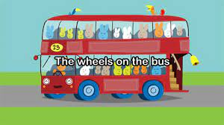
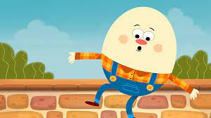

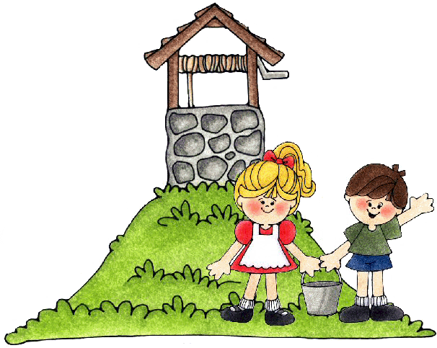


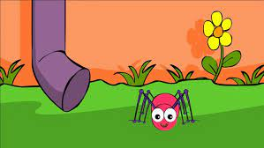
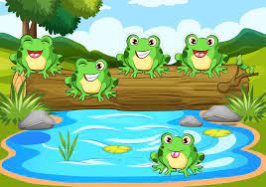
Talk Mat – Rhymes and Songs
Do you brush your teeth twice a day?
Can you sing all of these rhymes and songs? Can you spot the rhyming words in each one?
Humpty Dumpty
Remember to keep working towards the Langley Rainbow Challenge!
Jack and Jill
black
Incy Wincy Spider
Days of the Week
Monday Tuesday Wednesday Thursday Friday Saturday Sunday
5 Little Speckled Frogs

