Slide 1
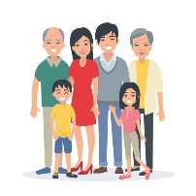
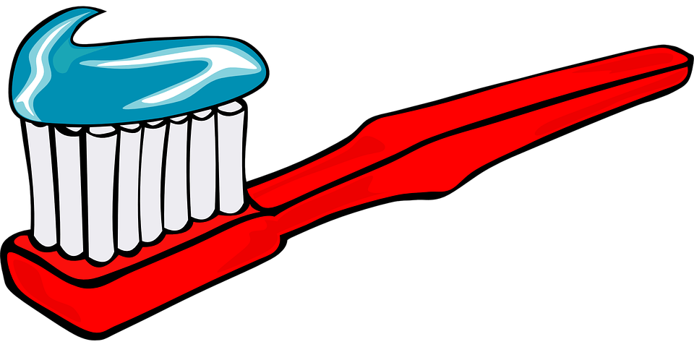


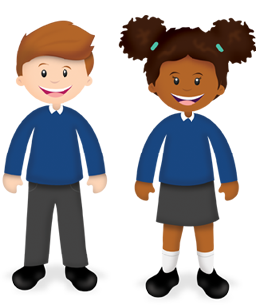


Talk Mat – All About Me!
Do you brush your teeth twice a day?
family
home
friends
Parts of the Body
face
head
Colours
red
arm
shoulder
green
purple
blue
yellow
Can you recognise your name?
pink
leg
hand
orange
black
brown
Can you use a pencil to make marks?
knee
foot
toes
Days of the Week
Monday Tuesday Wednesday Thursday Friday Saturday Sunday

