Slide 1
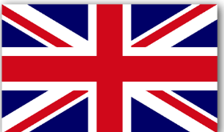
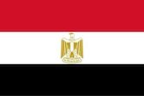
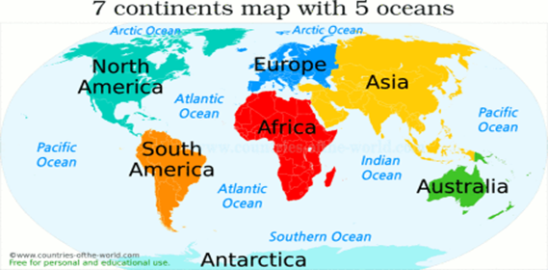
Knowledge Organiser – Year 2 – Where on Earth?
Key Vocabulary
Material | Something that an object is made from
Continents | Continents are made up of countries and there are seven in the world – Asia, Africa, South America, North America, Australasia, Antarctica, and Europe.
Oceans | A big sea and there are 5 in the world – Indian, Pacific, Southern, Atlantic, Artic.
Climate | The weather in a certain place
Town | A place where people live that is bigger than a village.
Village | A place where people live that is found in the countryside
Landscape | What you can see when you look out over an area of land
Factory | A building where people make things with machines
Farm | Land where someone grows plants or keeps animals.
Crops | Plants grown on a farm
Key Information
Where is Egypt?
Egypt is a country in Africa which is surrounded by the Mediterranean sea. The capital is Cairo. It is a very hot climate as it is near to the equator.
Where is Langley?
Langley is a small town in the West Midlands. It is a town with lots of factories. It has a high street with a supermarket, library, park and the church. Everything is close by and within walking distance.
 | Langley | Luxor
Houses | They many have more than one room for different purposes and they are made from bricks and have windows. | They are small and are made from mud and papyrus. They only have one room which they live in.
Landscape | There are lots of buildings, houses and factories. There is a park area with canals. | There is a river called The River Nile and lots of hills.
School | The children walk to school, or go on a bus or in a car. The building has playgrounds, 2 halls, classrooms and a computer room. | General village schools instructed in preliminary education and gave specialised education for specific careers such as a priest or a scribe.
Animals | Cats, dogs, rabbits, hamsters, ducks, fish | Camels, sand cat, sand rat, egyptian mongoose and a hyena.
Work | Many of the people who live in the town work in the local factories making things, they also work in local shops. | Many of the people who live in the city were bakers, scribes, priests, doctors, crafts people and merchants
Key Places
United Kingdom | Where we live and it is made up of 4 countries—England, Scotland, Wales, Northern Ireland.
Egypt | A country in Africa near to the Mediterranean Sea
Luxor | A city in upper Egypt
Langley | A town in the West Midlands where we live.
Equator | The imaginary line that runs the whole way round the Earth
Langley
Egypt
Equator

