Slide 1
Reading fluency
February 2026

Slide 2
1.Why is reading fluency important?
2.Our approach to reading fluency.
3.How you can help at home.

Slide 3
What is fluency?
Reading fluency is a child’s ability to read text smoothly, accurately, and with expression.
When a child is fluent they:
Recognize most words quickly without sounding them out.
Read at a comfortable pace (not too slow or rushed)
Use their voice to show meaning, like pausing at commas or changing tone for questions – in other words what you as a parent do at bedtime when you are reading stories to your children.

Slide 4
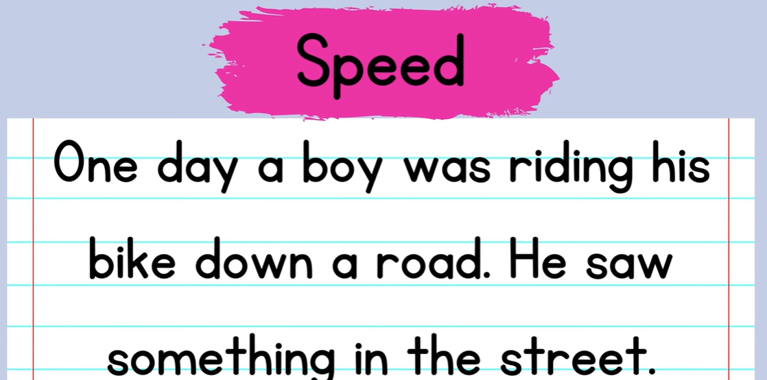

Slide 5
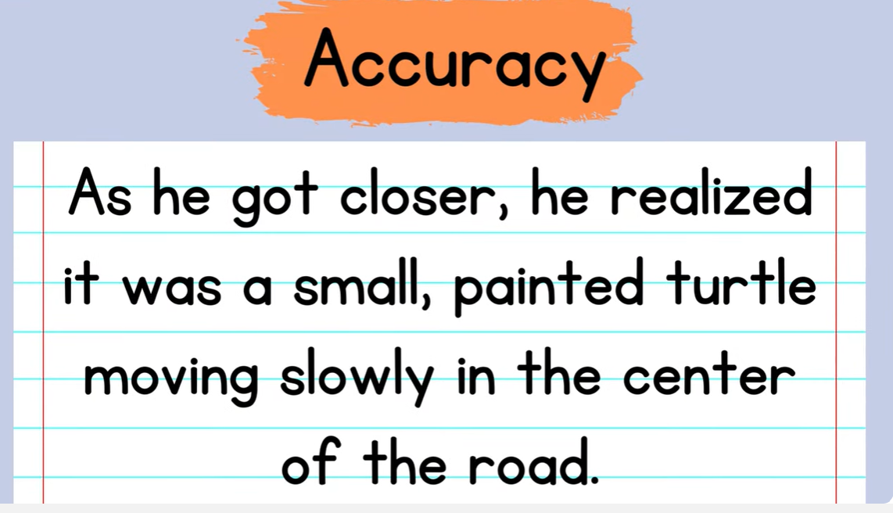

Slide 6
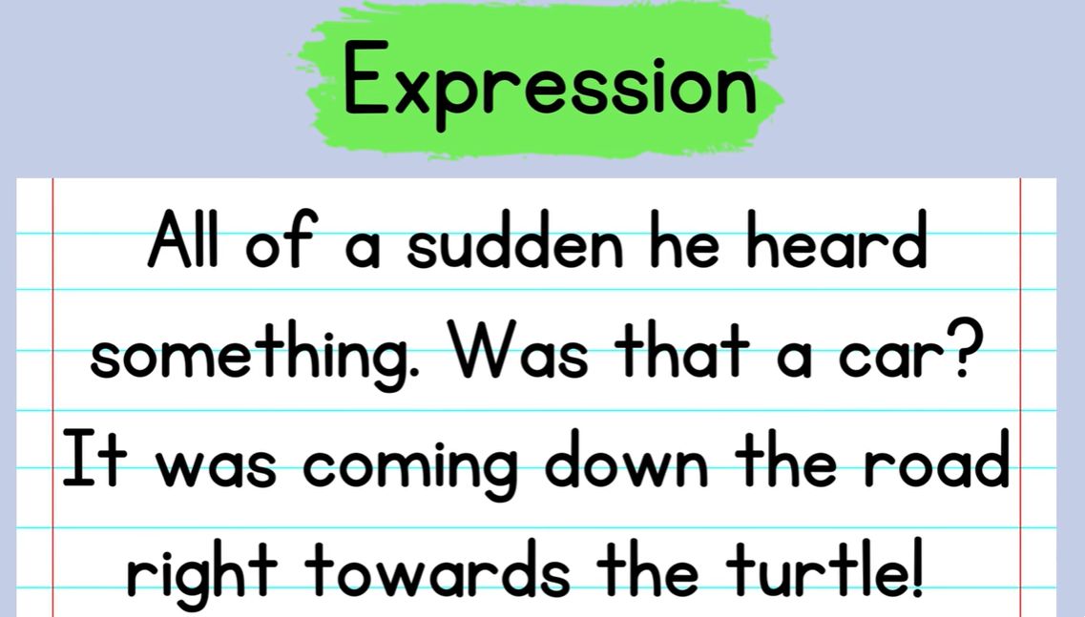

Slide 7
Why is fluency important?
Fluency matters because it helps children understand what they read. When reading feels easier and more natural, children can focus on the story or information instead of struggling with each word.
In short: fluent readers sound like they’re talking, not decoding. It is perfectly normal for children at the early stages of reading to sound out words and to read one word at a time. Reading fluency is the next step in learning to read.
With fluency, motivation and enjoyment increases.

Slide 8
Phonics gives children the skills to decode.
Decoding enables children to read fluently which allows children to achieve the ultimate aim, which is to gain meaning from text.
The best way to achieve this is through lots of reading practice and through fluent reading being modelled to them

Slide 9
Our approach to teaching fluency
To improve their fluency, children have a weekly fluency lesson.
The children work in mixed ability pairs.
The teacher models reading the text fluently and then discusses any unfamiliar vocabulary.
The children will then read alongside the class teacher
The children will then read in pairs, following along and supporting each other with any tricky words. They will each read the text at least twice. Teachers will circulate to hear readers.
As we read to gain understanding, we use questioning throughout the lesson to gain a picture of what children have understood from the text.
At the end of the lesson, children may volunteer to read to the class to demonstrate their fluency.

Slide 10
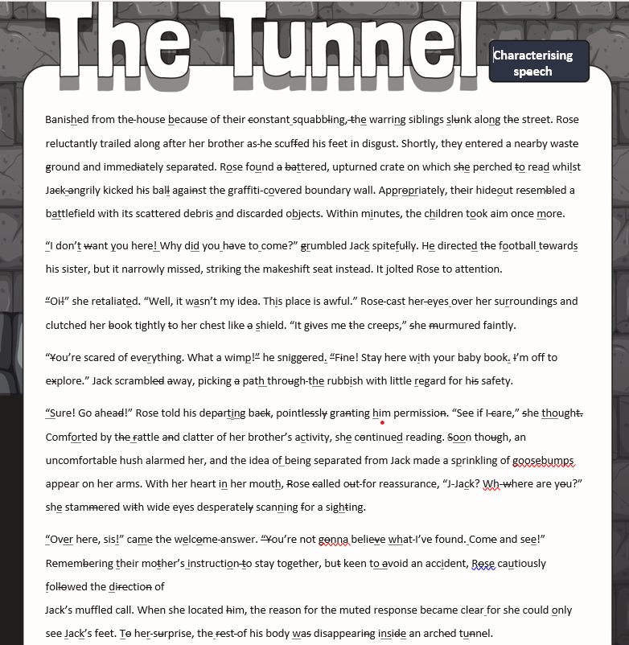

Slide 11
Guided reading
In this lesson children read a novel within a group over a period of several weeks. The novel is based on their reading ability and is based at a suitable level of challenge (more difficult than their home reader)
All groups receive at least one focused session per week with the class teacher. In their guided session the teacher will model fluency and spend the session discussing unfamiliar vocabulary and ensuring the children understand the text.
Shared Reading
Daily class reading of a book to develop listening comprehension, word knowledge, background knowledge and reading enjoyment

Slide 12
How can you help at home ?
Listen to your child read at least 3 times a week using some of the strategies we have discussed.
This could be a mixture of you reading to them , reading it together and them reading to you.
Discuss with your child any of the vocabulary that they are unsure of – they could have small strips of paper with the unknown words on that you revisit with them regularly.
Re read texts several times this supports fluency
Provide your child with a variety of reading material at home - link it to their interests.
Join the library !

